Slide 1

Féminin Pluriel Berlin
Introduction

Slide 2
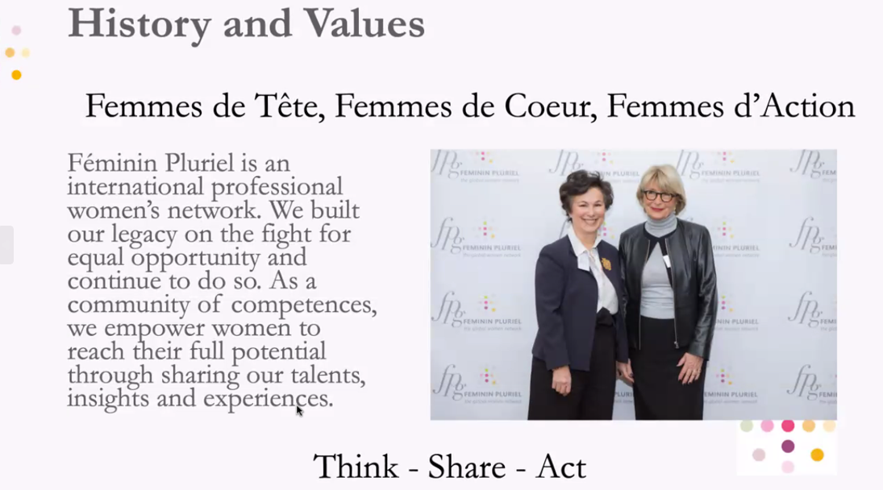
About Féminin Pluriel Global (FPG)
Féminin Pluriel is a non-profit organization, launched in 1992 in Paris by Beatrice Lanson Villat.
Féminin Pluriel as in “female” and “plural” reflects our purpose, which is to increase the professional and personal influence of women of all generations and profiles.

Slide 3


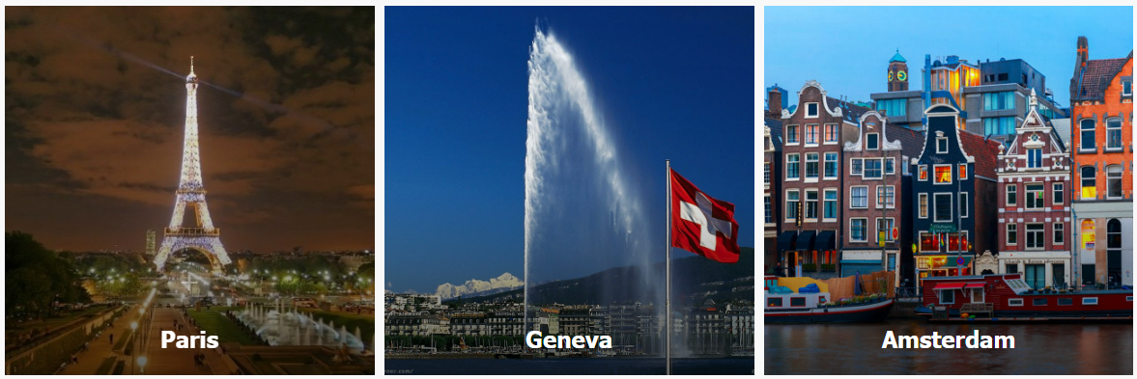
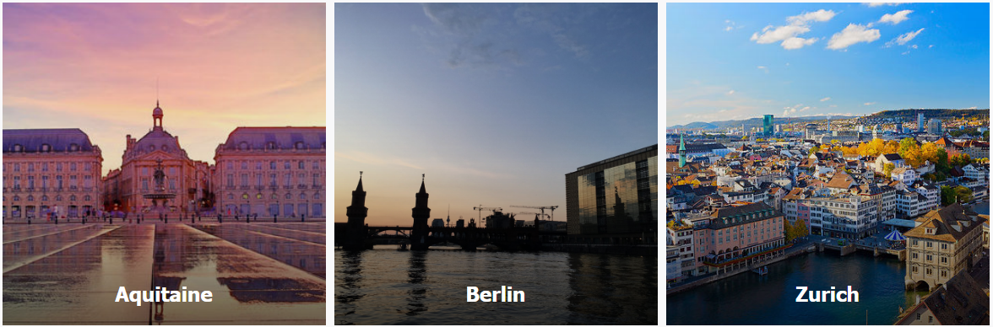
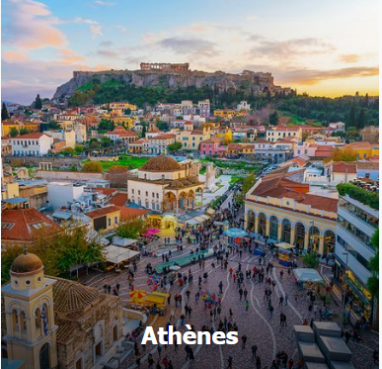


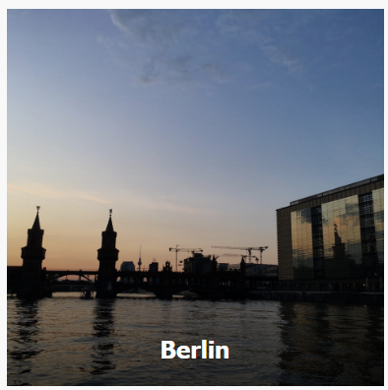
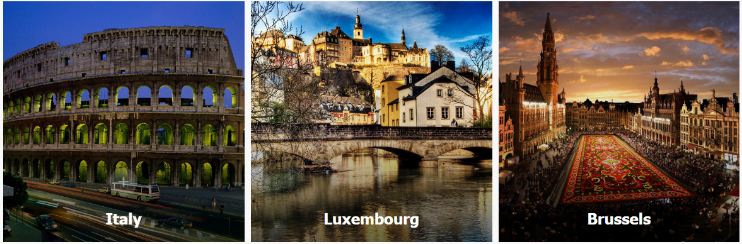
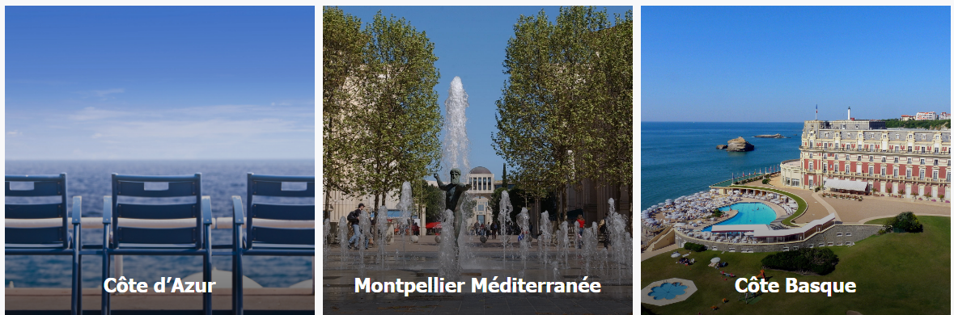

Féminin Pluriel Global (FPG)
Féminin Pluriel has grown into an international network with13 local clubs organizing local meetings and events
Each year, a global international conference brings together members of all clubs in one of the local Féminin Pluriel location

Slide 4
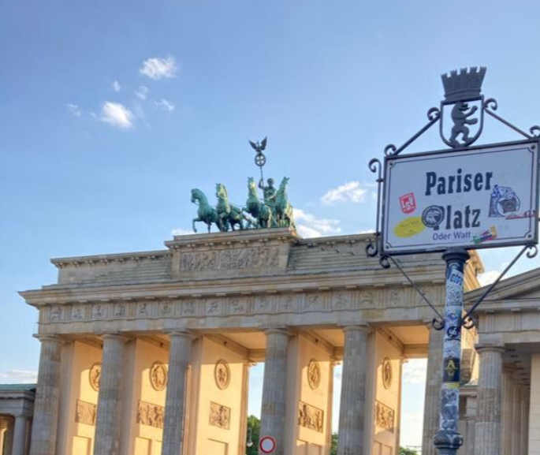
Féminin Pluriel Berlin
Féminin Pluriel Berlin (FPB) has for objectives to:
Support professional skills development, learning, mentoring, and
networking within the French/German communities and industries
Provide its members a network to connect, discuss challenges, test ideas and ultimately increase professional and personal influence
Organize events and discussions developing and promoting women’s contribution and influence in the economy
While the main objective remains professional, friendship and support for charitable and humanitarian causes in favor of women and youth are important to us.
Our members are
Féminin: mostly women but welcoming male or diverse allies
willing to make a positive contribution in supporting our objectives
Pluriel: our background, industry, international work life experience are diverse.
Berlin: while our headquarter and key events are in Berlin, we welcome members from all over Germany
Notes:
Promote the image of women as well as their role and influence in the business
Créer des événements, des réunions et des conférences sur divers sujets pour fournir une source de croissance personnelle et d'inspiration.

Slide 5
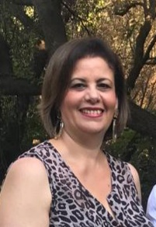
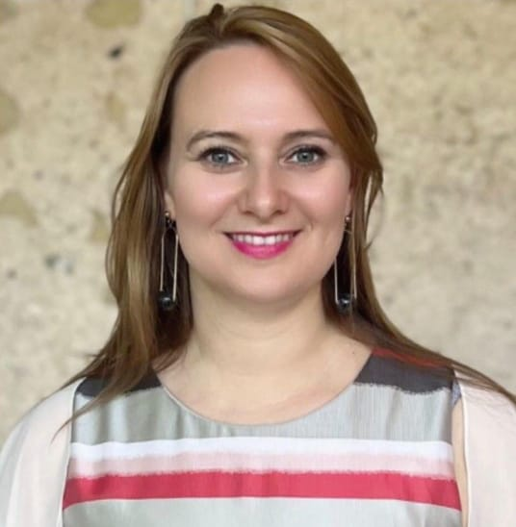
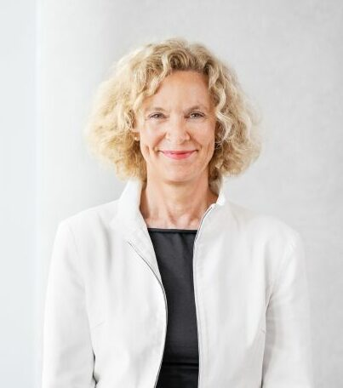
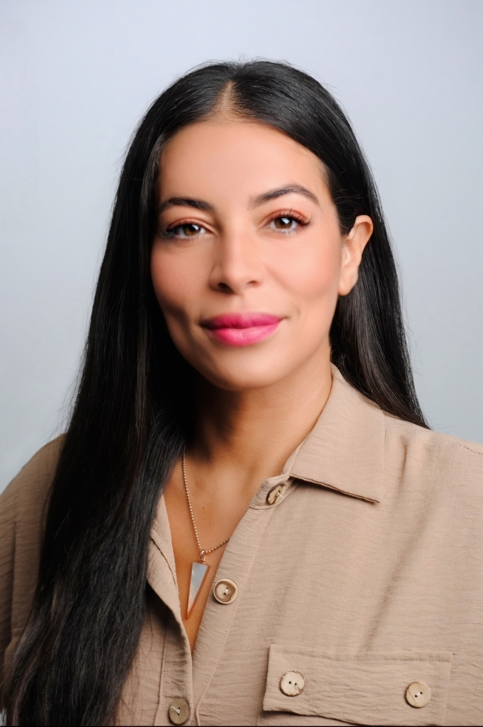
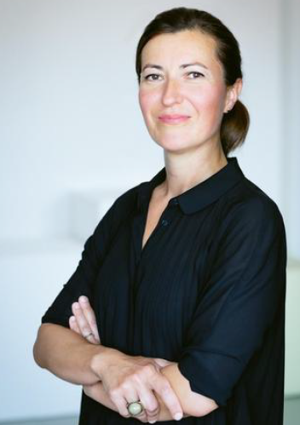
Féminin Pluriel Berlin: contacts
Dr. Fatima Sanfourche
President
Alina Navarro Melendo
Vice President and Legal Officer
Claudia Nickolaus
Treasurer
Isma Khemies
Communication
Officer
Amela Malja
Chief Partnership Officer
Address: Westfälische Strasse 86a, 10709 Berlin
Email: berlin@feminpluriel.org
Website: https://fp-berlin.org/
LinkedIn: https://linkedin.com/company/feminin-pluriel-berlin

Slide 6
Our activities
Promoting clarity, inclusion, and equality
Building business network
Encourage professional and leadership development
Coaching / Career / Conversations
Mentoring partnerships
Empower women to reach their full potential through sharing our talents, insights and experiences.
Influence : build a space where business leaders and policymakers collaborate to address shared challenges. This includes not only women’s roles but also economic growth, well-being, and the promotion of best practices toward achieving a society with perfect gender equality.
Ready to make a difference? Join us ! Visit our website at https: femininpluriel.org
and ‘Become a Member.’
Let’s empower each other!

